Slide 1
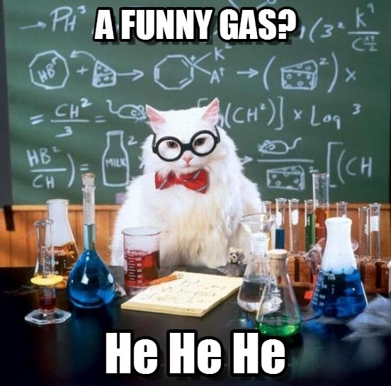

Slide 2
A2 Chemistry
Pressure, temperature and volume

Slide 3
Review
Kinetic Theory explains the behaviour of gases. It makes some assumptions which are true for ideal gases, but …

Slide 4
Objectives
The behaviour of an ideal gas, including the qualitative relationships between pressure, temperature and volume, can be explained using the Kinetic Theory

Slide 5

Gas Laws: Pressure and Volume
Boyle's Law states that, at constant temperature, the product of the pressure and volume of a given mass of an ideal gas in a closed system is always constant.

Slide 6
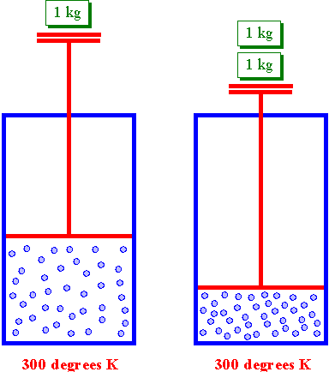

If a container, with a fixed number of molecules inside, is reduced in volume, more molecules will strike a given area of the sides of the container per unit time, causing a greater pressure.
Increasing the external pressure on a container will reduce the volume.

Slide 7
Gas Laws: Temperature and Volume
Charles' Law states that, for a given mass of an ideal gas at constant pressure, the volume is directly proportional to its absolute temperature, assuming a closed system.

Slide 8
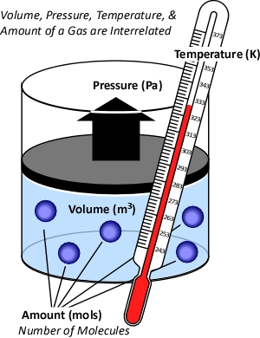
Heating a gas will cause the average kinetic energy of the particles will increase, so they will collide more forcefully with the walls of their container. If the container can expand, then the volume will increase as the pressure will remain balanced with the outside of the container.

Slide 9
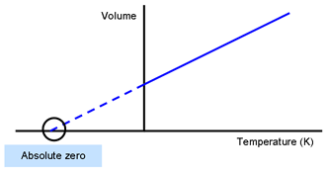

Temperature Conversions
This only works in the absolute temperature scale, so all temperatures must be in Kelvins.

Slide 10
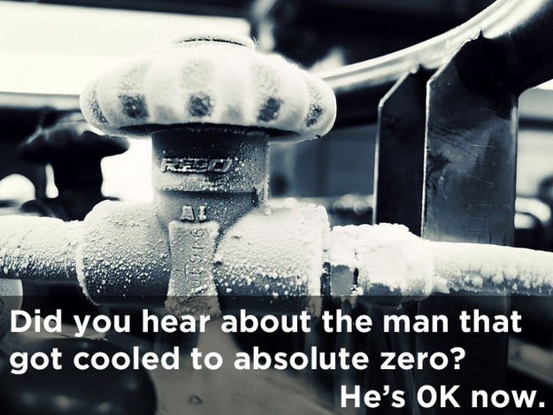

Slide 11


Combined Gas Law
If the container can’t expand then the pressure will rise but the volume will stay the same, so pressure, temperature and volume are all interrelated.

Slide 12
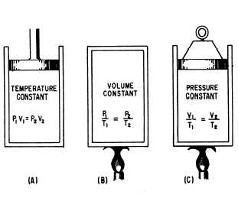

Slide 13
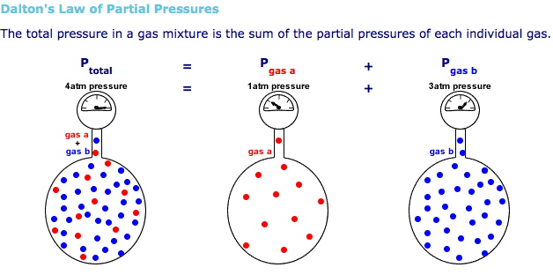
Partial Pressure
For mixtures of gases, eg gases collected over water, each gas’ particles will contribute its own collisions and therefore its own pressure.
Total pressure is the sum of each gas’ partial pressure.

Slide 14
